Slide 1
Week 13 Presentation
By J. Jedediah Smith

Slide 2
What was tried?
More troubleshooting with Rob.
Analyze assembled vs raw results from BugSeq.
Revise proposal draft.
Work on materials and methods for final paper.

Slide 3
How did it go?
Kraken2 reference database downloaded successfully! Now thinks a database file doesn’t exist that clearly does. Tried re-downloading all the data. Could be related to not having enough RAM.
CCMetagen reference database downloaded successfully! Now giving an error about being unable to allocate RAM. Increasing swap space to 31 GB did not fix the problem.
Proposal draft was revised and resubmitted!
I’ve written up a materials and methods section detailing what worked and what didn’t work.

Slide 4
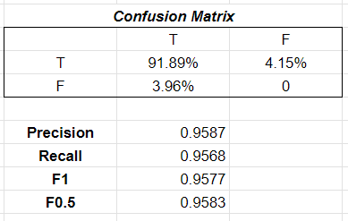
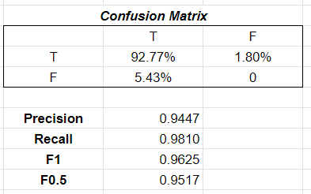
BugSeq Analysis
Assembled Results
Overall, have similar F1 and F0.5 scores.
Raw appears to have much better recall, at the expense of slightly poorer precision.
Raw Results

Slide 5
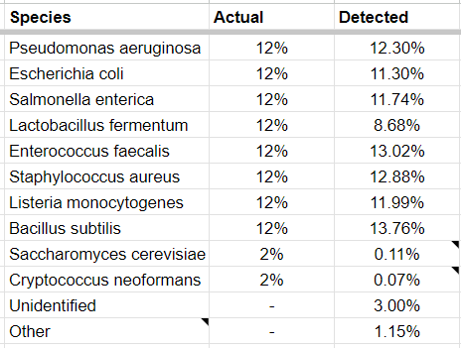
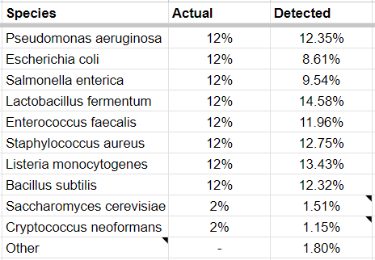
BugSeq Comparison
Assembled Results
Raw Results

Slide 6
Where to go next?
Server is having problems.
Can try Lindsey’s suggestions for down sampling to see if that addresses the lacking memory problem.
Try with more cores
Limit memory with SBATCH
Try to run Kraken2 in Conda
Pick up laptop?
Resubmit BugSeq data
May 2 final day for me, make sure to put a summary

